Slide 1
Fundamentals of deep learning for multi-gpus Lab 2, part 1: introduction to horovod

Slide 2











Training a Neural Network
Multiple GPUs
GPU
$$\hat{y}$$
$$ℒ(\hat{y},y)$$
GPU
$$ℒ(\hat{y},y)$$
$$\hat{y}$$
CPU/GPU
$$W^{[3]}=W^{[3]}− α∗\frac{∂ℒ}{∂W^{[3]}}$$
$$W^{[3]}=W^{[3]}− α∗\frac{∂ℒ}{∂W^{[3]}}$$
W^{[3]}
W^{[3]}
$$W^{[2]}=W^{[2]}− α∗\frac{∂ℒ}{∂W^{[2]}}$$
$$W^{[2]}=W^{[2]}− α∗\frac{∂ℒ}{∂W^{[2]}}$$
W^{[2]}
W^{[2]}
$$W^{[1]}=W^{[1]}− α∗\frac{∂ℒ}{∂W^{[1]}}$$
$$W^{[1]}=W^{[1]}− α∗\frac{∂ℒ}{∂W^{[1]}}$$
W^{[1]}
W^{[1]}
CPU/GPU
CPU/GPU

Slide 3

Meet horovod
Library for distributed DL
Works with stock TensorFlow, Keras, PyTorch, and MXNet
Installs with pip
Uses advanced algorithms; leverages high-performance networks (RDMA, GPUDirect).
horovod.ai

Slide 4
Meet horovod
Infrastructure team provides container and MPI environment
ML engineers use DL frameworks that they love
Both have consistent expectations for distributed training across frameworks
horovod.ai

Slide 5
Using Horovod

Slide 6
Initialize the library
import horovod.tensorflow.keras as hvd
hvd.init()

Slide 7
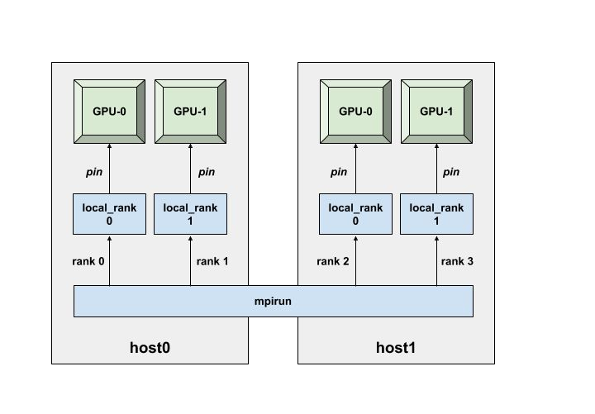
Pin gpu to be used
gpus = tf.config.experimental.list_physical_devices('GPU') if gpus: tf.config.experimental.set_memory_growth(gpus[hvd.local_rank()], True) tf.config.experimental.set_visible_devices(gpus[hvd.local_rank()], 'GPU’)

Slide 8
Add distributed optimizer
opt = hvd.DistributedOptimizer(opt)

Slide 9
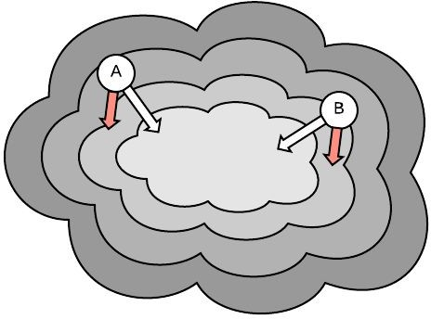
Synchronize initial state
callbacks.append(hvd.BroadcastGlobalVariablesCallback(0))
model.fit(..., callbacks, ...):
...

Slide 10
Checkpoint only on one worker
checkpoint_callback = tf.keras.callbacks.ModelCheckpoint(...)
if hvd.rank() == 0:
callbacks.append(checkpoint_callback)
model.fit(..., callbacks, ...):
...

Slide 11
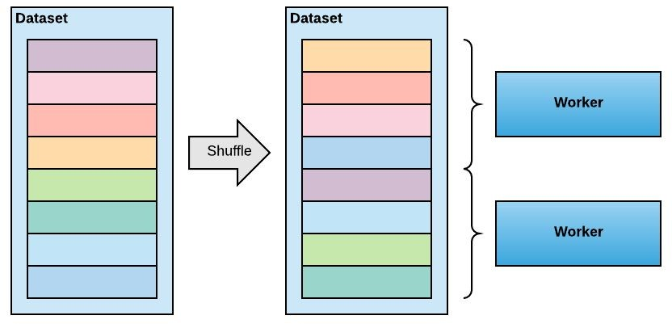
Data partitioning: option 1
Shuffle the dataset
Partition records among workers
Train by sequentially reading the partition
After epoch is done, reshuffle and partition again
NOTE: make sure that all partitions contain the same number of batches, otherwise the training will deadlock

Slide 12
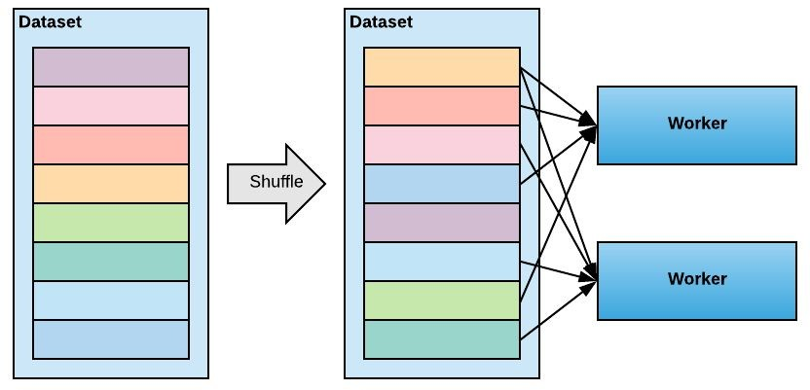
Data partitioning: option 2
Shuffle the dataset
Train by randomly reading data from whole dataset
After epoch is done, reshuffle

Slide 13
Horovod for all
import horovod.tensorflow as hvd
import horovod.tensorflow.keras as hvd
import horovod.torch as hvd
import horovod.mxnet as hvd

Slide 14
Running horovod
Single-node:
$ mpirun -np 4 python train.py
Multi-node:
$ mpirun -np 8 -H server1:4,server2:4 python train.py

